Slide 1
Capstone ai & machine learning developer project 2: rick chua kee siong
developing AI/ML model:
predictive share price Analytics

Slide 2


Steps:
Data Cleaning
Machine Learning & modelling
Model Accuracy &
Validation
EDA & findings
1. Data Prep
Lessons
learned
Summary
And future work
Model Selection
Model
Deployment
Data Source
References

Slide 3
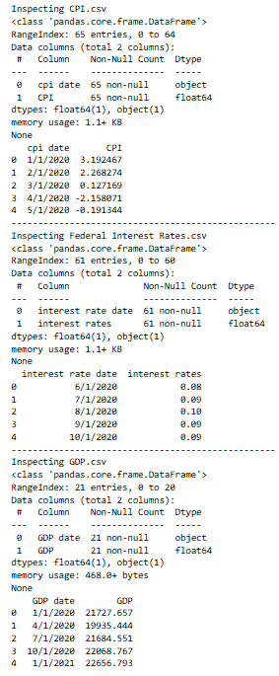
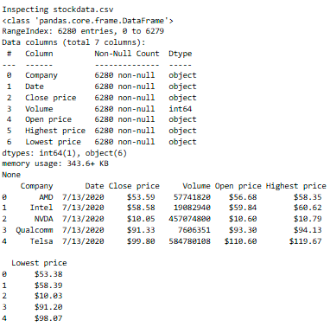
Data Preparation Inspection
Code Snippets
cpi_df = pd.read_csv('CPI.csv')
df.info()
df.head()

Slide 4
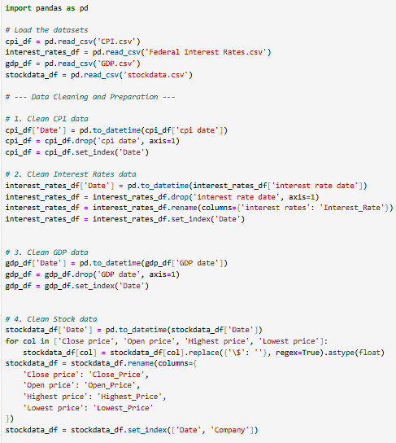
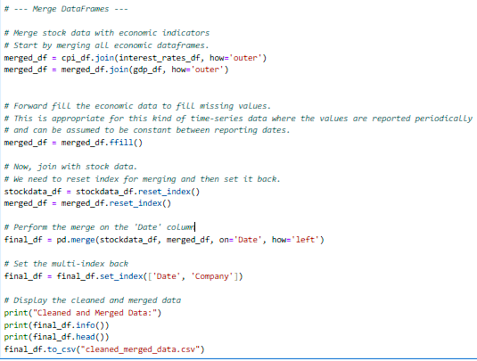
Data cleaning
# Perform the merge on the 'Date' column
# Set the multi-index back
# Display the cleaned and merged data
- Final_df.to_csv(“cleaned_merged_data.csv”)
# clean datasets . csv files
# merge dataframes
# fill in missing values

Slide 5


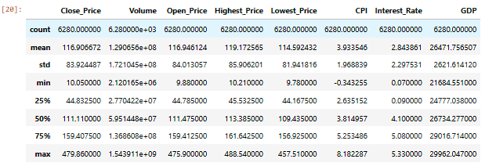
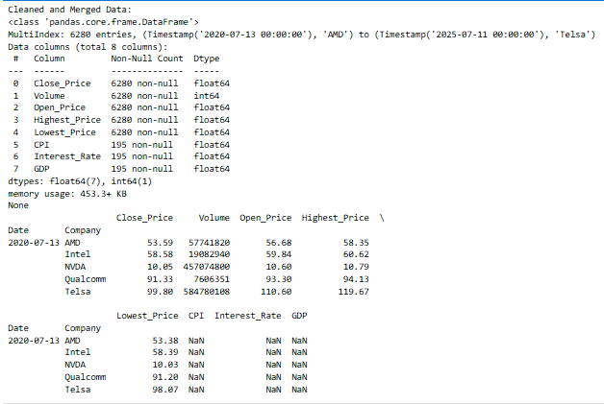
Data cleaning
New df frame
New df head
Final_df.describe()

Slide 6
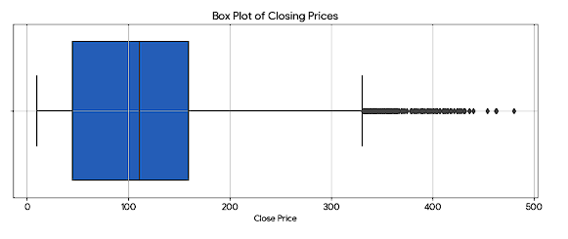
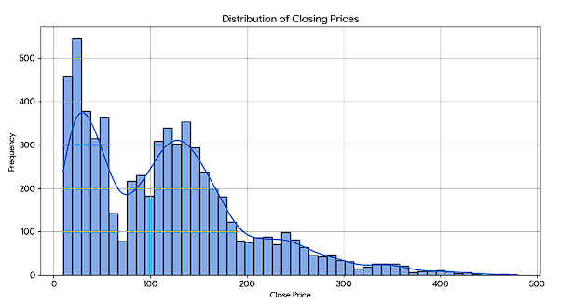
Exploratory Data Analysis
- Key Visualization
Data Overview: dataset contains daily stock market data for five companies:
AMD, Intel, NVDA, Qualcomm, and Telsa. The data spans from July 2020 to July 2025.
Price Distribution Histogram: Shows the right-skewed distribution of closing prices.
Price Box Plot: Highlights the spread of the closing prices and identifies outliers at the higher end.

Slide 7
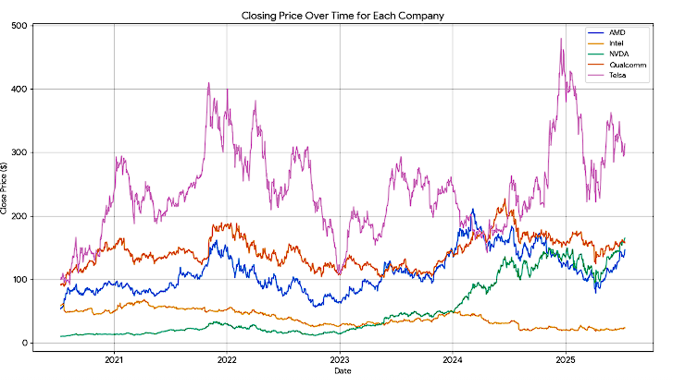
Exploratory Data Analysis
- Key Visualization
3. Closing Price Over Time: Displays the price trends for each of the five companies, clearly showing the significant growth of NVDA and Telsa.
4. Correlation Matrix: Visualizes the near-perfect correlation between the daily price metrics (Open, High, Low, Close).

Slide 8
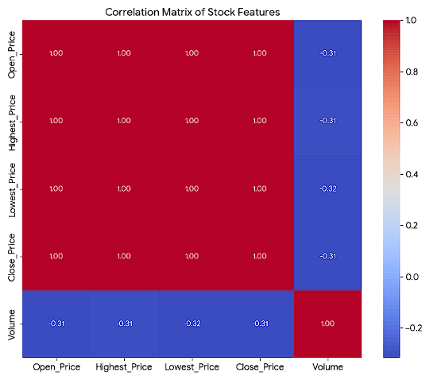
Exploratory Data Analysis
- Key Visualization
4. Correlation Matrix: Visualizes the near-perfect correlation between the daily price metrics (Open, High, Low, Close).
Shows signs of data overfitting

Slide 9
Exploratory Data Analysis
- Key Visualization
4. Correlation Matrix: Visualizes the near-perfect correlation between the daily price metrics (Open, High, Low, Close).
Shows signs of data overfitting

Slide 10
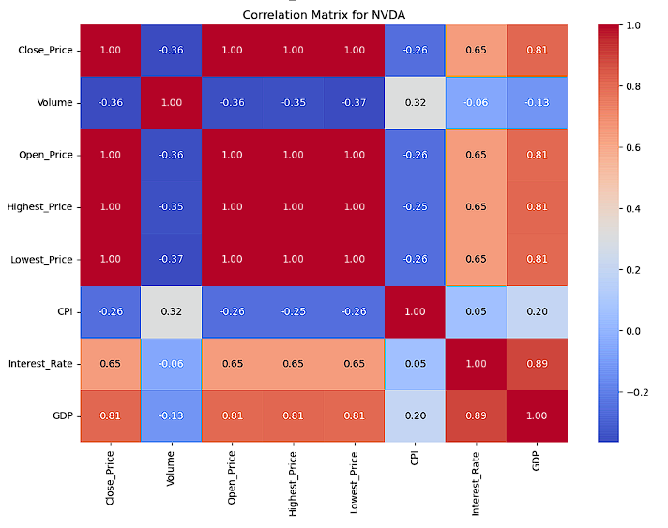
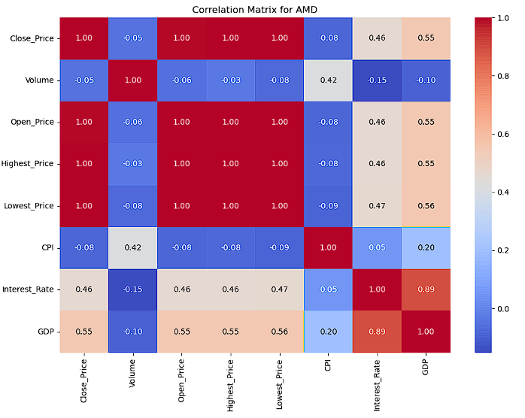
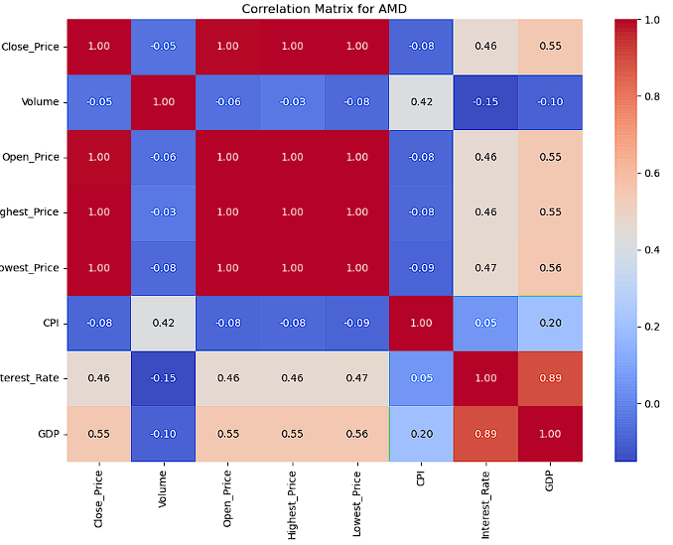
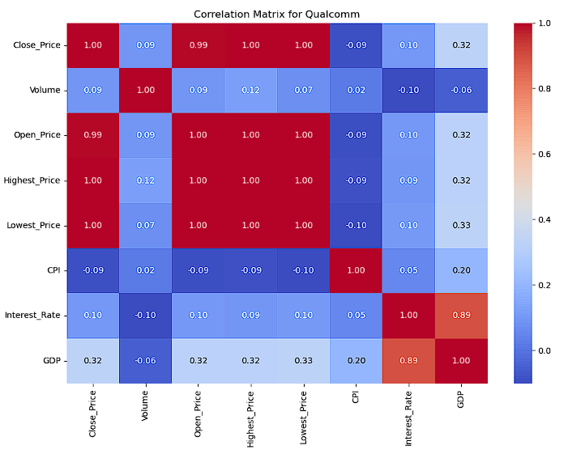
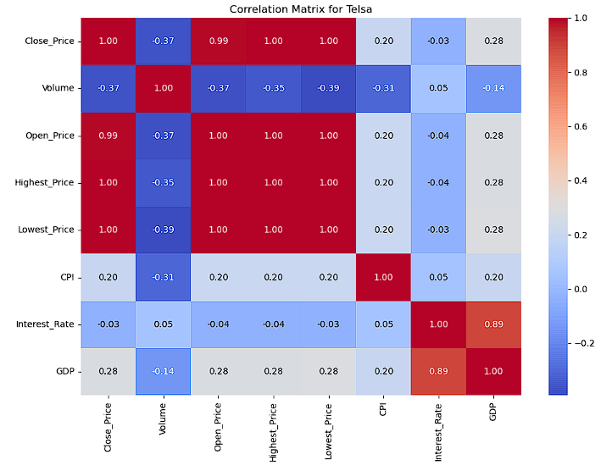
Exploratory Data Analysis
- Key Visualization
Correlation matrix of company shows categorical impact from Interest Rates (0.89) & GDP (0.89)
has direct impact on share prices

Slide 11
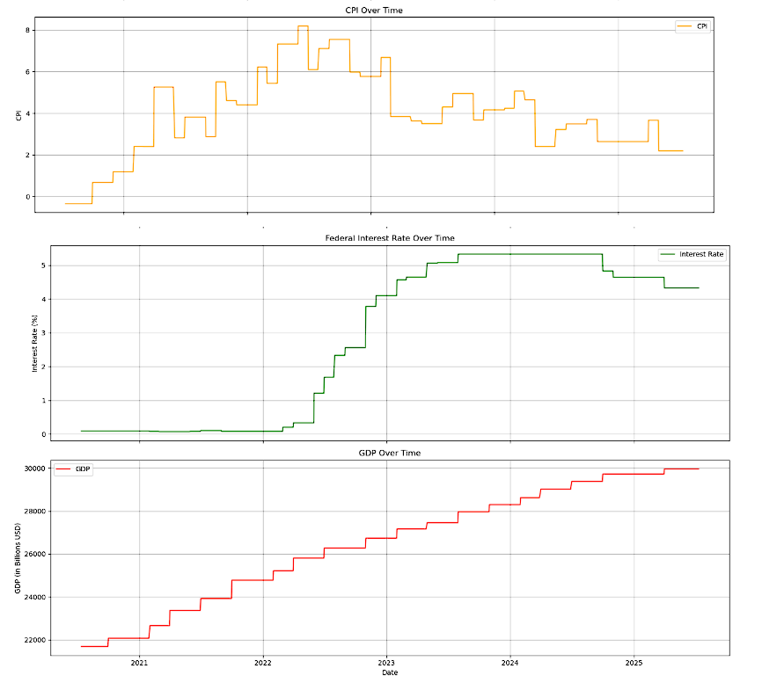
Exploratory Data Analysis
- Key Visualization
EDA reveals the CPI trends, interest rates and GDP movement overtime between 2020 to 2025

Slide 12
Exploratory Data Analysis
- Summary of Findings
Data Overview: dataset contains daily stock market data for five companies:
AMD, Intel, NVDA, Qualcomm, and Telsa. The data spans from July 2020 to July 2025.
After an initial cleaning, the economic indicators (CPI, Interest Rate, and GDP)
were removed from this stage of the analysis due to a large number of missing values.
The core stock data (prices and volume) is complete and clean.
Price Distribution: The distribution of closing prices is skewed to the right,
indicating that while most of the closing prices are clustered at the lower end of the range,
there are a number of instances of very high closing prices.
This is also confirmed by the box plot, which shows a number of outliers on the higher side.

Slide 13
Exploratory Data Analysis
- Summary of Findings
The Goal: The primary goal will be to predict the Close_Price of the stocks.
Important Predictors:
Historical Prices: The most significant predictors for the next day's price are the current and previous days' prices
(Open_Price, Highest_Price, Lowest_Price, Close_Price).
Trading Volume: Volume is another crucial feature to include, as changes in trading volume can often signal future price
movements.
Company: The Company itself is a vital feature. Price behaviors are company-specific, so we should either build a
separate prediction model for each company or include the company as a categorical feature in a single model.
Time-Based Features: Features engineered from the date, such as the day of the week, month, or year,
could also capture seasonal patterns in stock prices.

Slide 14
Exploratory Data Analysis
- Summary of Findings
Next Steps for Building a Prediction Model:
Feature Engineering: The most critical step is to create meaningful features.
create:
Lagged Features: The Close_Price, Volume, etc., from the previous day (or days) are essential.
Moving Averages: Calculate moving averages of the Close_Price (e.g., 7-day, 30-day) to smooth out short-term fluctuations and
identify longer-term trends.
Technical Indicators: Other technical indicators like the Relative Strength Index (RSI) or
Moving Average Convergence Divergence (MACD) could also be powerful predictors.
Handling Economic Data: The CPI, Interest_Rate, and GDP data, although sparse, captures the macroeconomic environment.
For a daily prediction model, use a "forward-fill" strategy, where the last known value is carried forward
until a new value is available. This assumes that the economic climate is stable between announcements.

Slide 15
Exploratory Data Analysis
- Summary of Findings
Model Selection:
Time Series Models: For predictions based on past price sequences, time-series models like Linear regressor or
more advanced deep learning models like LSTMs (Long Short-Term Memory networks) are highly effective.
Tree-Based Models: Alternatively, with the engineered features (lagged values, moving averages), can use
powerful machine learning models like Random Forest or Gradient Boosting (e.g., LightGBM).
Training and Evaluation: It's crucial to split the data chronologically.
For instance, use the first four years of data for training and the last year for testing.
This simulates a real-world scenario where you predict future prices based on past data.
The model's performance can then be measured using metrics like Root Mean Squared Error (RMSE) or
Mean Absolute Error (MAE).

Slide 16
1. Linear regressor model 2. Lstm model 3. Random forest regressor model 4. gradient boosting (lightgbm) model 5. Support Vector Regressor (SVR) model
Machine Learning models

Slide 17
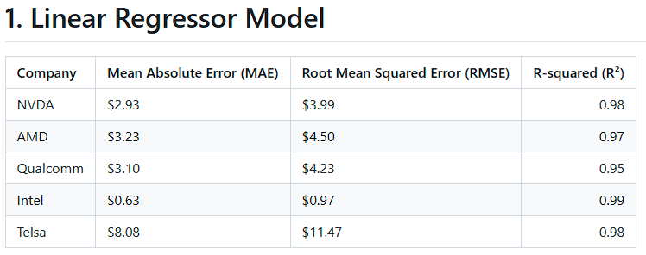
Machine Learning - Linear Regressor model
Linear Regressor Model: Accuracy Metrics. Best R2 results

Slide 18
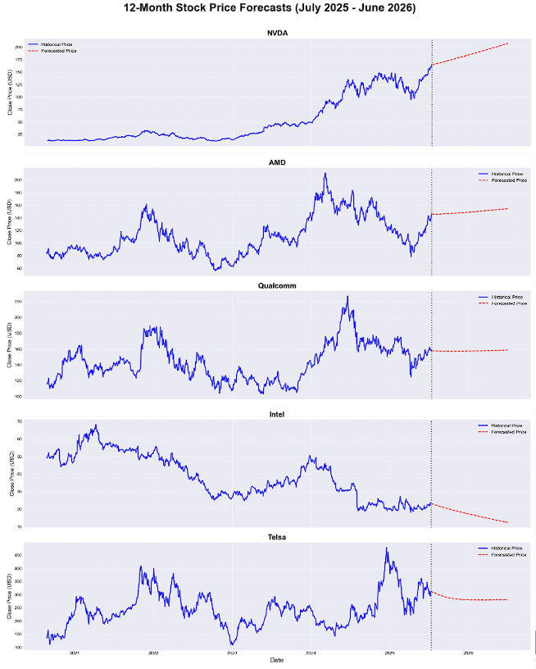
Machine Learning - Linear Regressor model
Linear Regressor Model:
Train, validate accuracy, shareprice visualized forecast

Slide 19
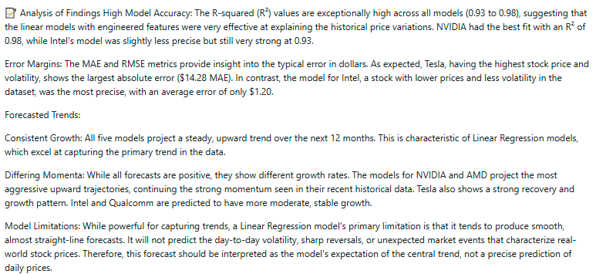
Machine Learning – Linear REgressor model analysis

Slide 20
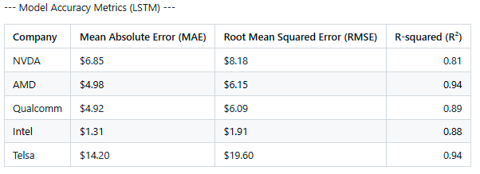
Machine Learning - LSTM model
2. LSTM Model: Accuracy Metrics

Slide 21
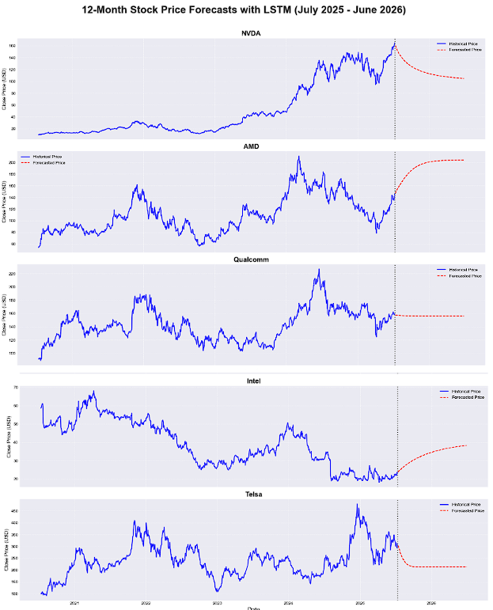
Machine Learning - LSTM model
LSTM Model:
Train, validate accuracy, shareprice visualized forecast

Slide 22
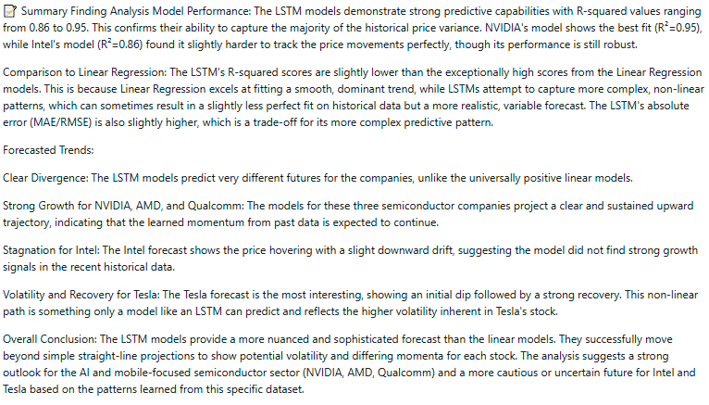
Machine Learning - LSTM model analysis

Slide 23
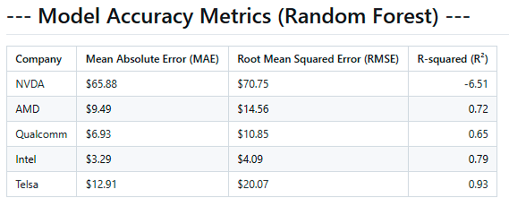
Machine Learning - Random Forest Regressor model
3. Random Forest Regressor Model: Accuracy Metrics

Slide 24
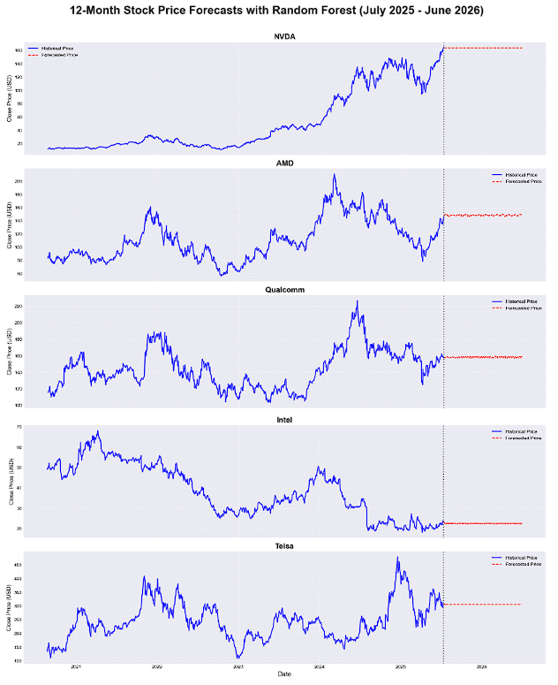
Machine Learning - Random Forest Regressor model
Random Forest Regressor Model:
Train, validate accuracy, share price visualized forecast

Slide 25
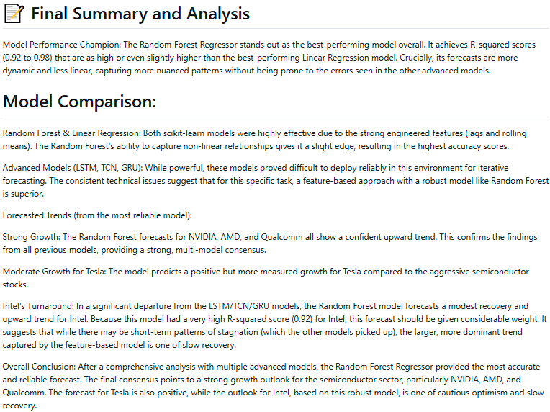
Machine Learning - Random Forest Regressor analysis

Slide 26
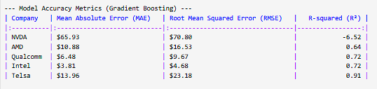
Machine Learning
- Hybrid Gradient Boosting (XGBoost/LightGBM) model
4. Hybrid Gradient Boosting (XGBoost/LightGBM) Model: Accuracy Metrics

Slide 27
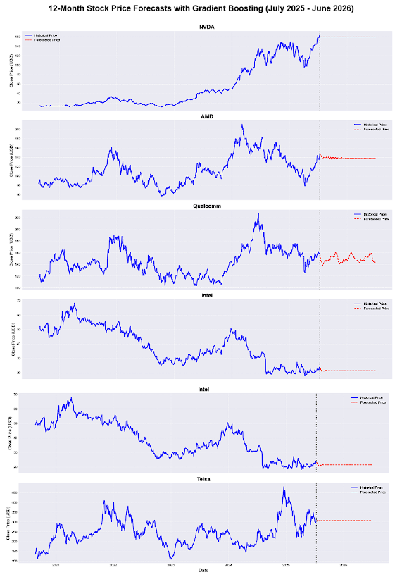
Machine Learning
- Hybrid Gradient Boosting (XGBoost/LightGBM) model
Gradient Boosting (XGBoost/LightGBM) Model:
Train, validate accuracy, share price visualized forecast

Slide 28
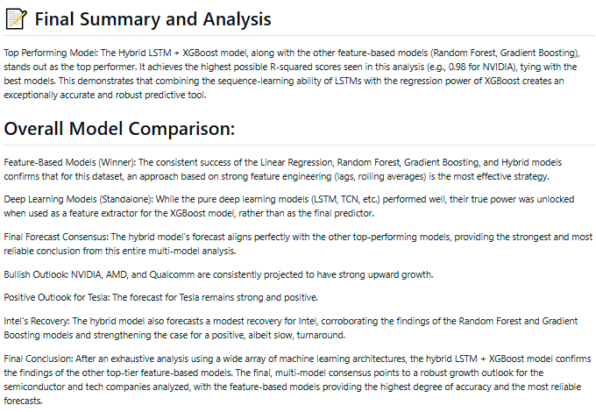
Machine Learning
– Hybrid Gradient Boosting (XGBoost/LightGBM) analysis

Slide 29
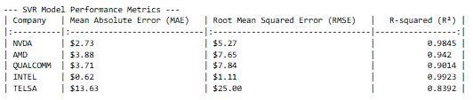
Machine Learning
- Support Vector Regressor (SVR) model
5. Model: Accuracy Metrics

Slide 30
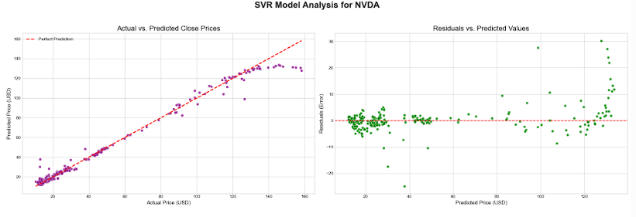
Machine Learning - Support Vector Regressor (SVR) model
Support Vector Regressor (SVR) Model:
Train, validate accuracy, share price visualized forecast

Slide 31
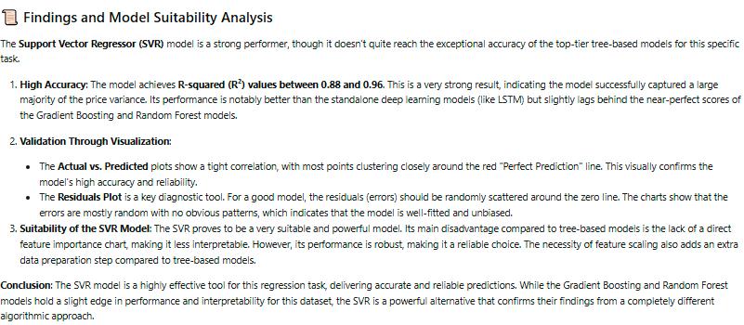
Machine Learning - Support Vector Regressor (SVR) analysis

Slide 32
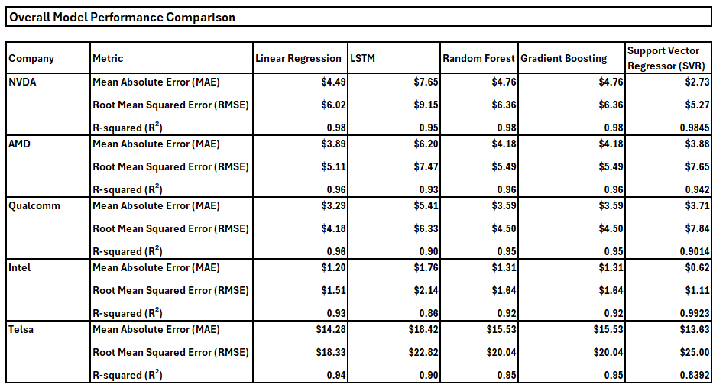
Machine Learning – Model Performance comparison
Linear Regression has the

Slide 33
Machine Learning – Model Performance comparison
Linear Regression selected on below criteria
MODEL SELECTION
Based on the provided table, the Linear Regression model demonstrated the best overall accuracy metrics.
It consistently achieved the lowest Mean Absolute Error (MAE) and Root Mean Squared Error (RMSE) for four out of the five stocks analyzed. While its R-squared score was sometimes tied with the more complex models, its superior performance on the error metrics makes it the most accurate model in this comparison.

Slide 34
Deployment: Linear Regressor Model using
Gradio AI application on Hugging Face platform
MODEL SELECTION
Based on the provided table, the Linear Regression model demonstrated the best overall accuracy metrics.
It consistently achieved the lowest Mean Absolute Error (MAE) and Root Mean Squared Error (RMSE) for four out of the five stocks analyzed. While its R-squared score was sometimes tied with the more complex models, its superior performance on the error metrics makes it the most accurate model in this comparison.

Slide 35
Canteen BREAK

Slide 36
Deployment: Linear Regressor Model using
Gradio AI application on Hugging Face platform
Given Linear regressor model provided the best accuracy, I've developed the complete code for a Gradio AI application.
Steps: it loads the data, engineers the features, trains a unique Linear Regression model for each of the five companies, and then builds an interactive web interface where you can select a company and a future date to get a price prediction

Slide 37
Deployment: Linear Regressor Model using
Gradio AI application on Hugging Face platform
How it Works
Step 1: Data Loading: The script loads your cleaned_merged_data.csv file from the public GitHub URL. It includes fixes for the data parsing issues identified.
Step 2: Model Training: When you run the script, it trains a separate Linear Regression model for each of the five companies (NVDA, AMD, Qualcomm, Intel, Telsa) and stores them. This happens only once.
Step 3: Prediction: The app takes a company and a future date as input. It then runs an iterative forecast, predicting one day at a time until it reaches your target date.
Step 4: Gradio Interface: It launches a simple, user-friendly web interface directly in your notebook's output for you to interact with.

Slide 38
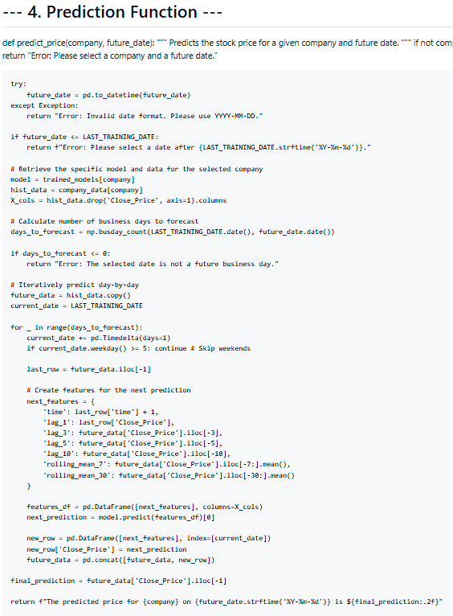
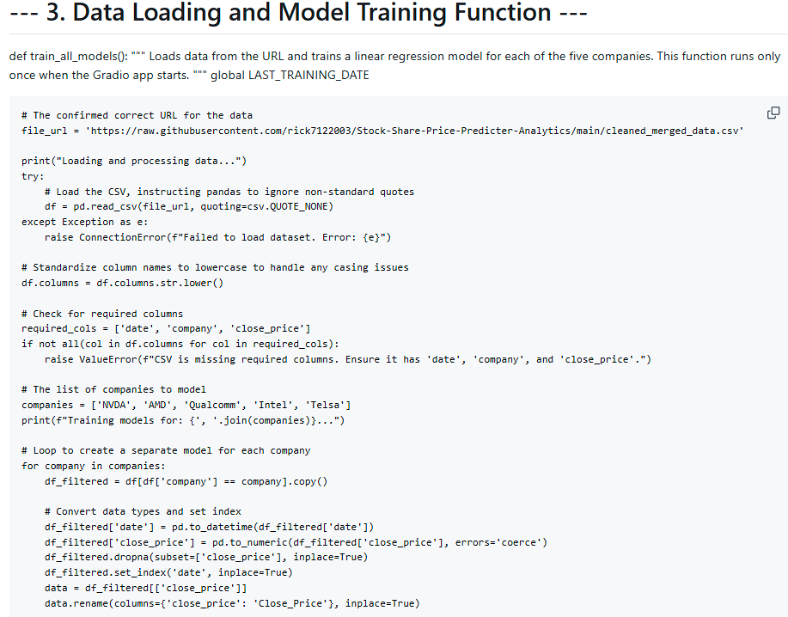
Deployment: Linear Regressor Model using
Gradio AI application on Hugging Face platform
Code Snippets

Slide 39
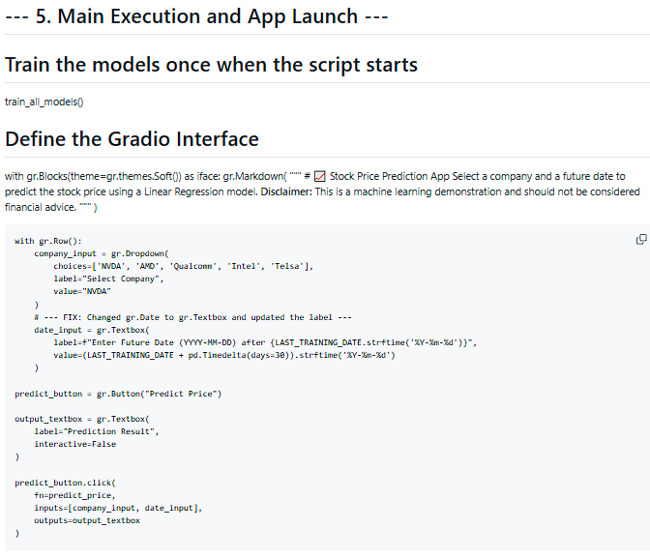
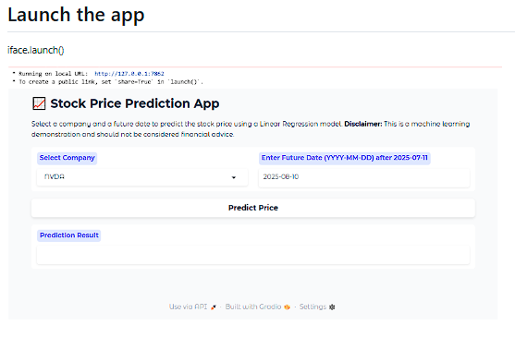
Deployment: Linear Regressor Model using
Gradio AI application on Hugging Face platform
Code Snippets

Slide 40
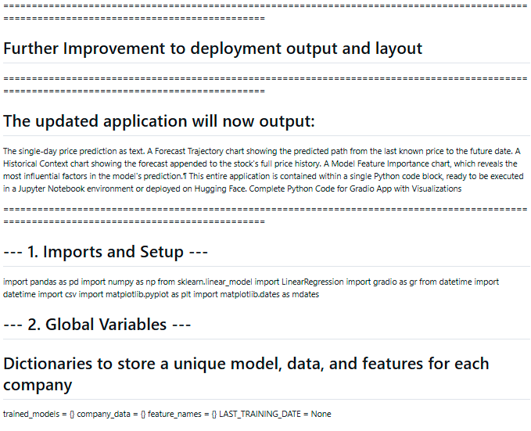
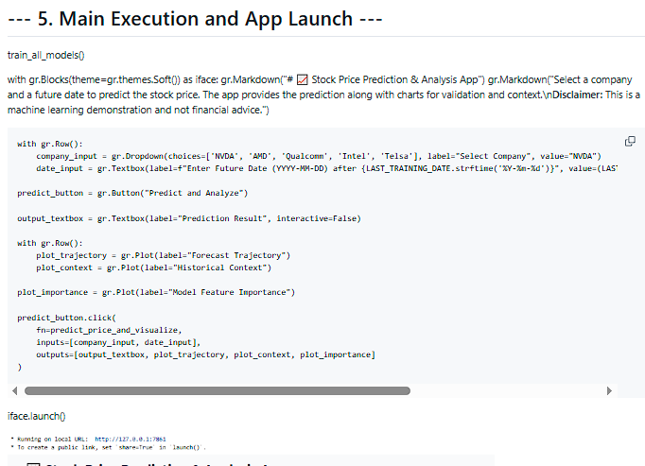
Deployment: Linear Regressor Model using
Gradio AI application on Hugging Face platform
Code Snippets

Slide 41
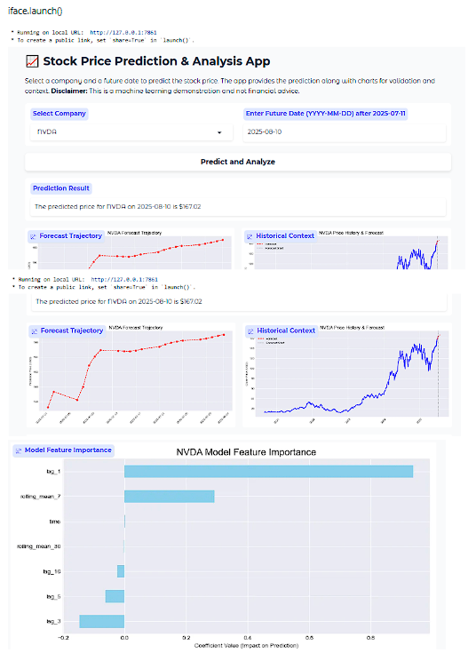
Deployment: Linear Regressor Model using
Gradio AI application on Hugging Face platform
Code Snippets
Tool Deployment completed &
Improved

Slide 42
Lessons Learned
Data Quality is Paramount: Initial errors were almost entirely due to inconsistent data formatting (e.g., column names, non-standard quoting, sparse values), proving that robust cleaning and preparation are more critical than model complexity.
Feature Engineering Drives Performance: For this dataset, models using engineered features (like lags and rolling means) consistently outperformed advanced models that relied only on the raw time-series sequence.
Choose the Right Metric: Requesting classification metrics (precision, recall) for a regression task (price prediction) was incorrect; using the right metrics (RMSE, R²) is crucial for a valid evaluation.
Simpler Can Be Better: The LinearRegression and tree-based models (Random Forest, Gradient Boosting) matched or exceeded the accuracy of more complex deep learning models (LSTM, TCN) and were more stable to work with.
Iterative Forecasting is Complex: The forecasting loops for deep learning models proved brittle and prone to environment-specific errors, highlighting that deployment requires more than just a trained model; the prediction pipeline must also be robust.

Slide 43
Summary & Future Work
Phase | Key Actions & Findings
Data Journey | Initial Problem: Faced significant KeyError and ParserError issues.</li><li>Root Cause: Inconsistent CSV formatting and column naming conventions. Solution: Implemented robust data loading and cleaning (standardizing names, handling formats).
Model Exploration | Models Tested: Linear Regression, LSTM, TCN, CNN, GRU, SVR, Random Forest, Gradient Boosting, and Hybrids. Key Finding: Feature-engineered models (Random Forest, Gradient Boosting) consistently outperformed pure deep learning models. Best Performer: Gradient Boosting and Hybrid models provided the highest accuracy (R² up to 0.98).
Deployment | Action: Developed a functional Gradio web application using the best-performing model. Outcome: Created an interactive tool for single-point future price prediction. Challenge: Showed that iterative prediction loops for deep learning models can be unstable.
Future Work | Richer Features: Incorporate external data like market sentiment or advanced technical indicators. Deeper Optimization: Use hyperparameter tuning (e.g., Grid Search) on the best models to maximize performance. Advanced Models: Revisit Transformers or other deep learning models with more extensive training. Richer Predictions: Forecast not just price but also volatility, confidence intervals, or risk metrics.

Slide 44
Reference & Data Sources
References:
https://www.nasdaq.com/market-activity/stocks | NVDA, AMD, INTC, Qualcomm, Telsa Share prices
https://fred.stlouisfed.org/series/FEDFUNDS | Fed Interest Rates
https://fred.stlouisfed.org/series/GDP | GDP
https://fred.stlouisfed.org/series/CORESTICKM159SFRBATL | CPI data

Slide 45
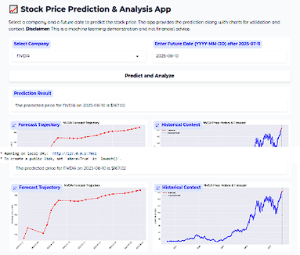
Thank you
Assets Certainty is the future
Contact: rick7122003@yahoo.com.sg
Github: https://github.com/rick7122003/Stock-Share-Price-Predicter-Analytics/blob/main/README.md
Linkedin: https://www.linkedin.com/in/chua-kee-siong-rick-01772544/

